Slide 1
Advancing PEPFAR Program Quality Assurance Through HIV Rapid Diagnostic Test Lot Testing
USAID Global Health Quality Assurance Program
June 7, 2024
Ashini Fernando, PhD, MPH (FHI 360)
David Jenkins, PhD (FHI 360)
Roger Peck (PATH)

Slide 2
Objectives
Introduction to FHI 360 and USAID partnership
PEPFAR HIV RDT lot testing program
HIV RDT lot testing standardization
HIV RDT testing outcomes

Slide 3
FHI 360 and USAID Partnership
FHI 360’s Product Quality and Compliance (PQC) department provides independent and objective quality assurance and quality control services to clients.
PQC has staff in the United States, Thailand, and South Africa; ISO 17025-accredited testing laboratories in United States and Thailand; ISO 9001-certified quality management system.
Through the USAID Global Health Supply Chain-Quality Assurance Program (GHSC-QA), FHI 360 delivers comprehensive quality assurance services employing a risk-based approach to ensure the safety, efficacy, and quality of health commodities procured on behalf of USAID.
GHSC-QA contract objectives
Quality assurance
Quality control
Technical assistance
Global collaborations
USAID Global Health Supply Chain Program

Slide 4
PEPFAR HIV RDT Lot Testing Program
Test method development
Sampling strategy
Product manufacturing consistency monitoring
Incident management
1
Notification of HIV RDT orders (and incidents)
Communicate results and next steps
to procurement groups
GHSC-QA
Procurement groups
WHO-prequalified
HIV RDTS
5
4
Coordinate with
sampling agents
2
Result reporting
within 6 weeks
200 HIV RDT samples mailed
3 testing laboratories
Sampling agents
3
Notes:
Most of the incident reports are around FNs or invalids;
Testing labs: PATH, UOM and FHI 360
the objective of lot testing isn’t to replace regulatory review, or even guide selection or algorithm use by country. The goal is to conduct ongoing independent evaluations of product consistency

Slide 5
HIV RDT Testing Standardization
Guided by ISO 2859-1:1999 Sampling Procedures for Inspection by Attributes
Key questions addressed:
How many HIV RDTs to test? Sample Size
What are the attributes applied to accept or reject a lot? Nonconformant results
What should be the percent level of nonconformant results in a lot that is tolerated by a user? Acceptance Quality Limits (AQL)
Factors considered: stringency, WHO guidance on HIV RDT sensitivity and specificity, waste
How should we qualify specimen panels?
Factors considered: specimen types, availability, cost, and storage
How should the RDTs be monitored? Sampling plan

Slide 6
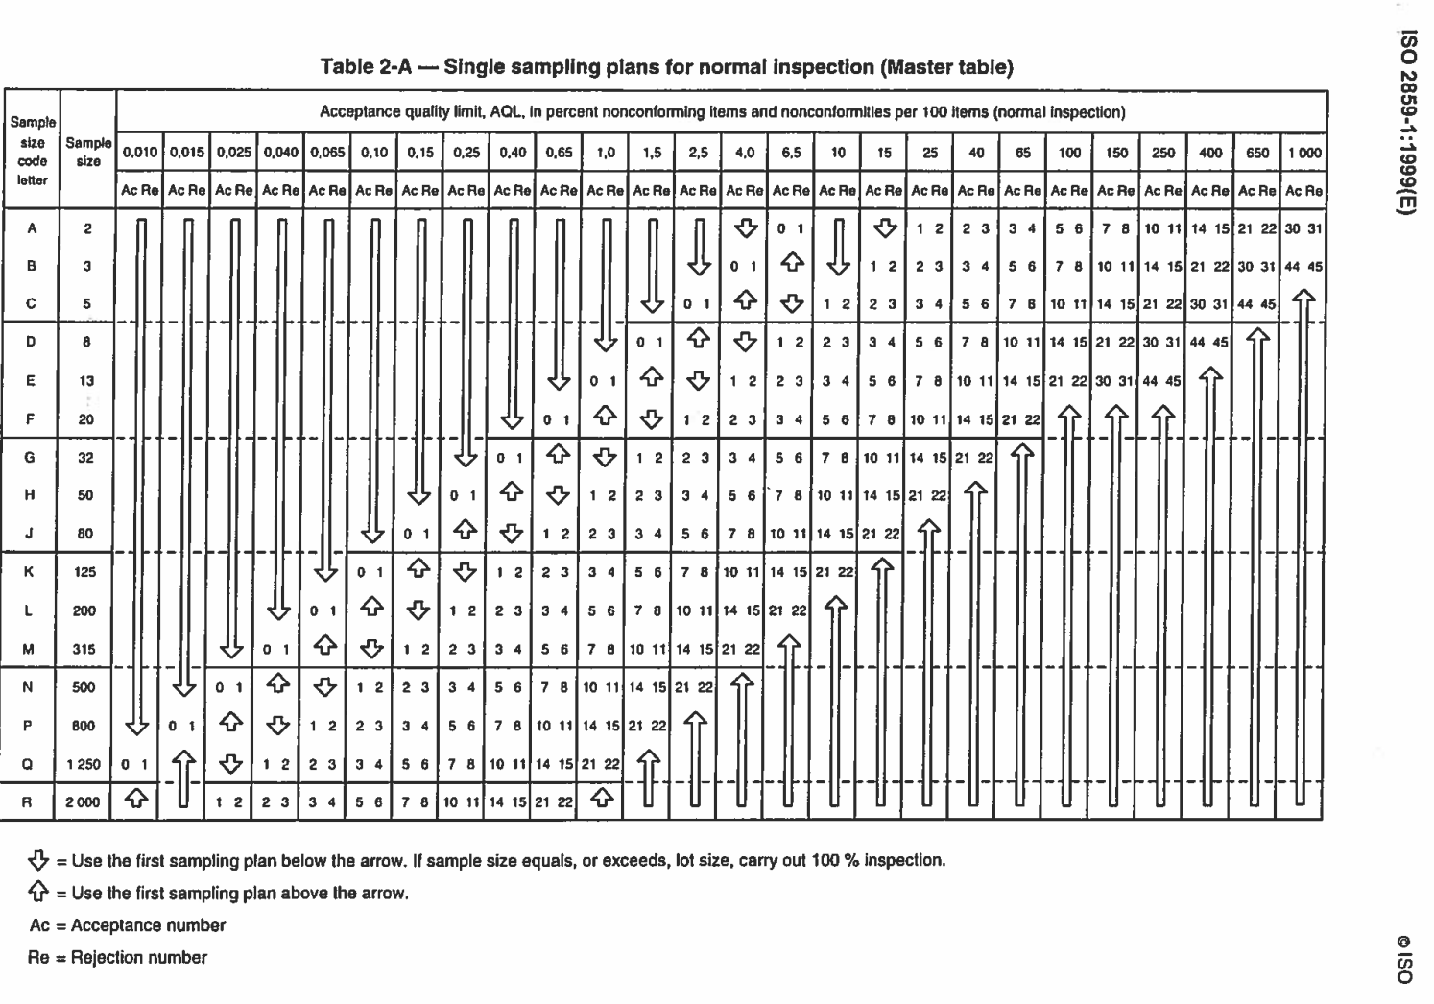
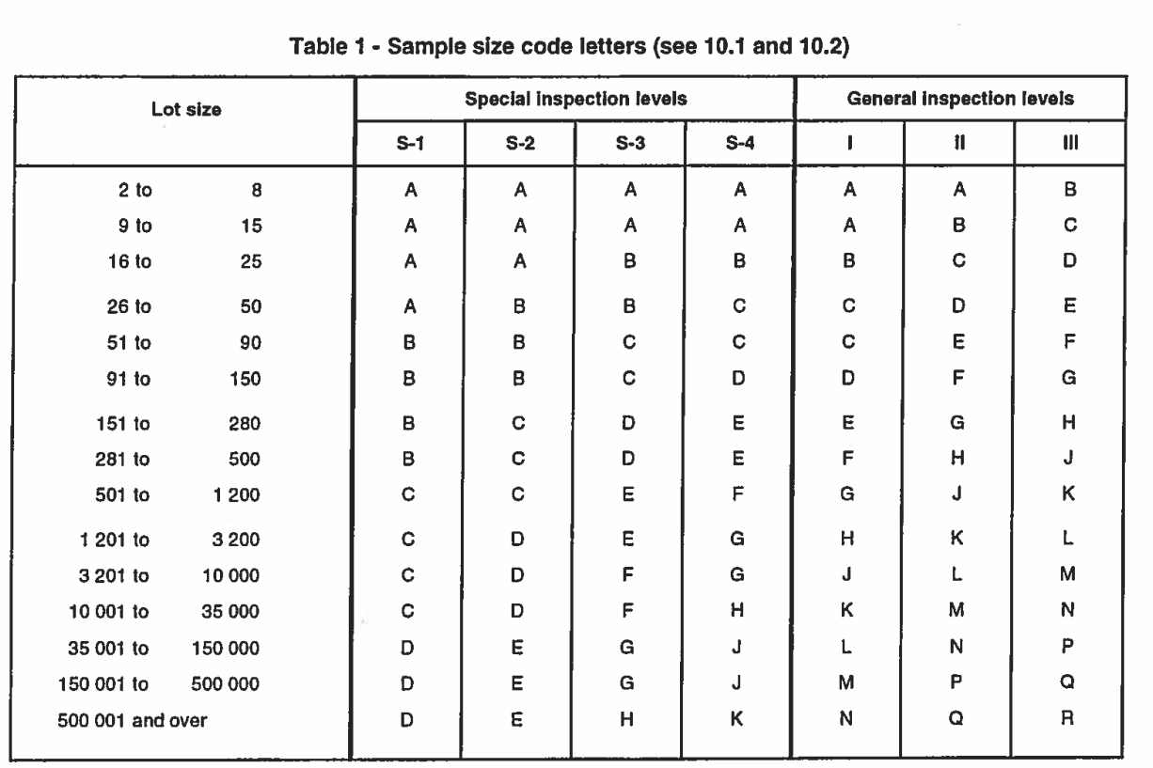
Sample Size and Acceptance Quality Limit (AQL) Determination Based on ISO 2859-1
Stringency
Stringency

Slide 7
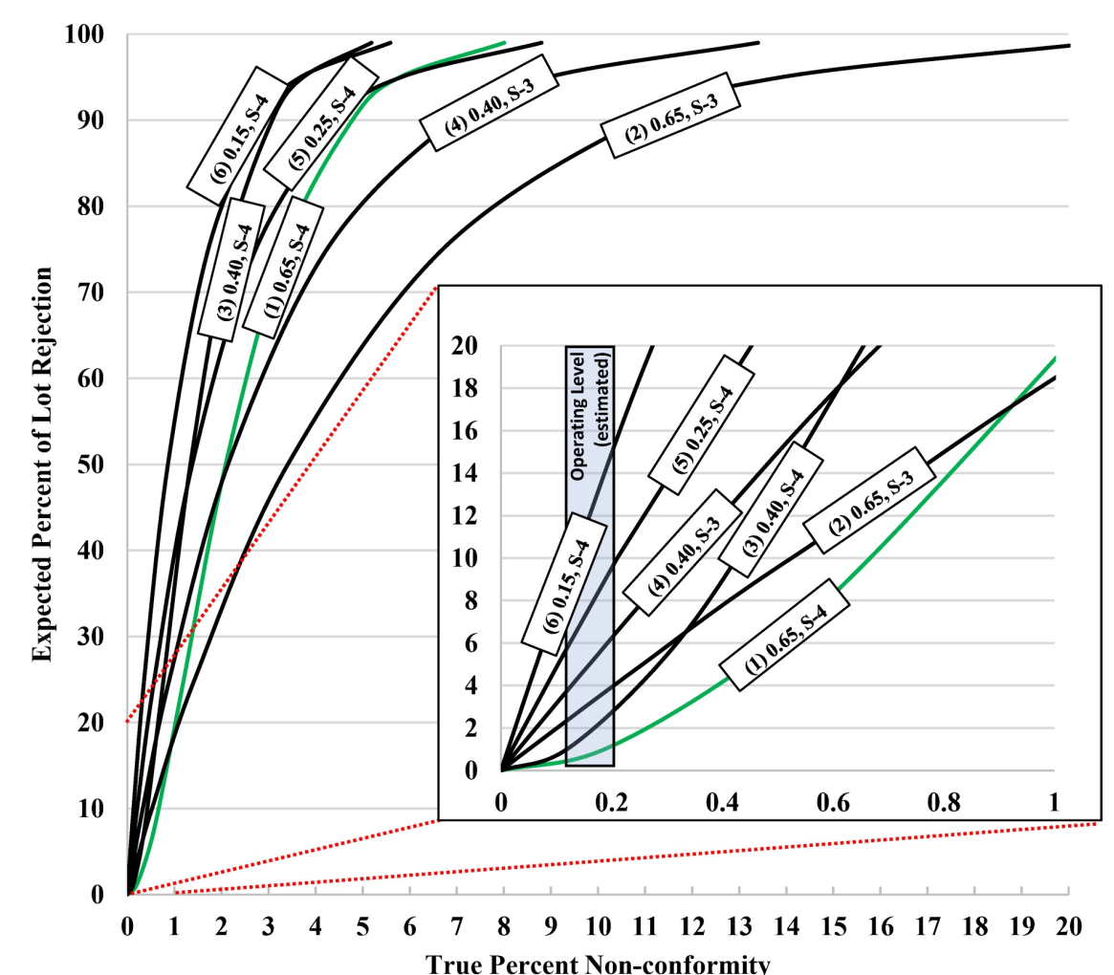
Optimal AQL and Inspection Level for HIV RDTs: 0.65, S-4
Sampling plan
80 HIV-positive unique specimens with 80 HIV RDTs
80 HIV-negative unique specimens with 80 HIV RDTs
AQL: accept 1 nonconformant
reject 2 nonconformants
Alternative sampling plan
20 positive specimens in quadruplicate with 80 RDTs
20 negative specimens in quadruplicate with 80 RDTs
AQL: accept 1 nonconformant
reject 2 nonconformants
PloS One, 18(4), e0284175. https://doi.org/10.1371/journal.pone.0284175

Slide 8
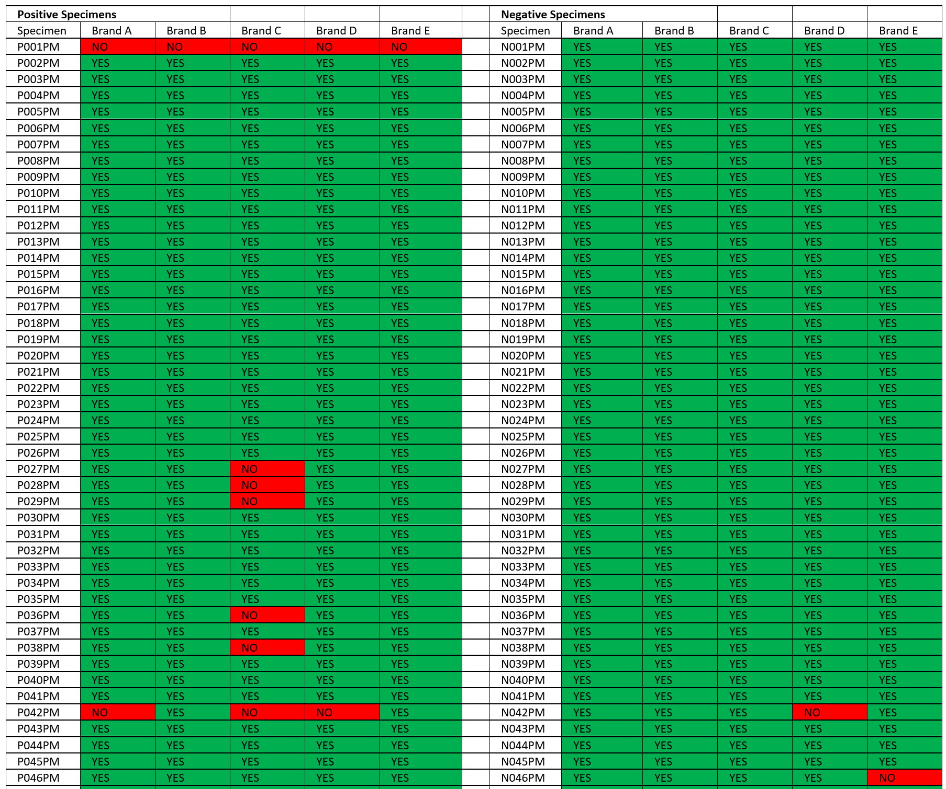
A Snapshot of HIV Specimen Panel Qualification Outcomes with 5 HIV RDT brands
Each specimen in 4 replicate/panel
3 lots per brand of HIV RDTs tested

Slide 9
HIV RDT Sampling Plan
 | Qualification Score | Minimum lots tested to reach next levels | Test frequency | Sample number to test
Testing level 1 | - | 15 | 100% | 80 positive and 80 negative
Testing level 2 | 75 | 50 | 100% | 80 positive and 80 negative
Testing level 3 | 250 | 75 | Skip lot 1 in 4 | 80 positive and 80 negative
Testing level 4 | 375 | - | 1 per quarter | 20 positive and 20 negative
*Qualification score determination
For 80 positives and 80 negatives; AQL 0.65, 1 accept/2 reject
If a lot is accepted with 0 nonconformities, add 5 to the qualification score
If a lot is accepted with 1 nonconformity, add 1 to the qualification score
Any lot not accepted results in the QA being reset to 0
ISO 2859-3: Skip lot sampling procedure
USAID Global Health Supply Chain Program

Slide 10
PEPFAR HIV RDT Lot Testing Outcomes
Approximate number of HIV or HIV/syphilis combo brands tested: 24
Lots tested
Lots not tested
7 lots rejected
I incident
Total lots procured 2,516

Slide 11
Investigation Results in Improvements to the Instructions for Use for a HIV Rapid Diagnostic Test
Product was quarantined after yielding false positive results.
Testing through GHSC-QA and by the manufacturer found a higher rate of invalid results occurred when the RDT was used directly on a laboratory bench or a plastic surface, but invalid results did not occur when tests were used on a paper-backed surface. This phenomenon is attributed to static electricity that affects the volume of buffer dispensed in a droplet from the buffer bottle.
As a result of the investigation:
The manufacturer prepared updates to the instructions for use to read that testing be performed on a paper-based surface.
Manufacturer submitted a notification of labeling change to WHO Prequalification. This labeling change will safeguard future procurements that use this HIV RDT as a component of their testing algorithm.
FHI 360 and PATH worked closely and communicated regularly with global stakeholders including WHO, USAID, the Global Fund, the USAID Global Health Supply Chain-Technical Assistance (GHSC-TA) program, and the USAID Global Health Supply Chain-Rapid Test Kit (GHSC-RTK) program. FHI 360 also maintained a positive collaboration with the manufacturer as each entity worked to investigate the concern of invalid results

Slide 12
Acknowledgments
This work was supported through the United States Agency for International Development Contract No. AID-OAA-C-15-00001
FHI 360
David Jenkins, PhD
Mary Beth Sowers
Michael Payne
Arno Hensens
Jeffery Tremelling
PATH
Roger Peck
Becky Barney
University of Maryland, Baltimore
Niel Constantine, PhD
USAID Global Health Supply Chain Program

